Slide 1
CS3391 Object Oriented Programming
Dr.D.Sivaganesan, Professor, PSGiTech / CSE
CS8392 Object Oriented Programming Dr.D.Sivaganesan and N.Aravindhraj PSGiTech / CSE
1

Slide 2
DataOutputStream dout = new DataOutputStream(fos);
dout.writeInt(67); dout.writeFloat(123.56f); dout.writeDouble(1345.123); dout.writeBoolean(true); dout.writeChar('D'); dout.writeChars("SIVAGANESAN");
FileInputStream ios= new FileInputStream("write.txt"); DataInputStream din = new DataInputStream(ios);
int a = din.readInt(); float b = din.readFloat();
double c = din.readDouble(); boolean d = din.readBoolean(); char e=din.readChar();
String str=din.readLine();
CS8392 Object Oriented Programming
Dr.D.Sivaganesan and N.Aravindhraj PSGiTech / CSE
2

Slide 3
import java.io.*;
class fwrite
{ public static void main(String args[]) throws IOException
{ //writing the data using DataOutputStream
try
{
FileOutputStream fos= new FileOutputStream("write.txt");
DataOutputStream dout = new DataOutputStream(fos); dout.writeInt(67);
dout.writeFloat(123.56f); dout.writeDouble(1345.123); dout.writeBoolean(true); dout.writeChar('D');
dout.writeChars("SIVAGANESAN");
}
catch(FileNotFoundException ex) System.out.println("Cannot Open the Output File");
// reading the data back using DataInputStream
{
}
try { FileInputStream ios= new FileInputStream("write.txt"); DataInputStream din = new DataInputStream(ios);
int a = din.readInt();
float b = din.readFloat(); double c = din.readDouble(); boolean d = din.readBoolean(); char e=din.readChar();
String str=din.readLine();
System.out.println("Values: " + a + " " + b + " " + c+" " + d +" "+ e +" "+str);
}
{
catch(FileNotFoundException e) System.out.println("Cannot Open the Input File"); } } }
CS8392 Object Oriented Programming
Dr.D.Sivaganesan and N.Arvaindhraj PSGiTech / CSE
3

Slide 4
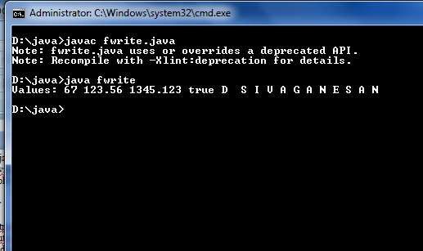
CS8392 Object Oriented Programming
Dr.D.Sivaganesan and N.Arvaindhraj PSGiTech / CSE
4

Slide 5
Use of Read / Write Stream methods
import java.io.*;
class exrwbyte
{public static void main(String args[]) throws IOException
{
byte[] b = {'E', 'N', 'G', 'I', 'N','E','E','I','N','G'};
try {
// create a new output stream
FileOutputStream fos = new FileOutputStream("exbyte.txt");
// create a new input stream
FileInputStream fis = new FileInputStream("siva1.txt"); FileInputStream fis2 = new FileInputStream("reset.txt"); BufferedInputStream bis=new BufferedInputStream(fis2); FileInputStream fis1 = new FileInputStream("www.txt");
// write something fos.write(b, 1, 8);
//fos.flush(); // read byte byte c[]= new byte[15]; fis.read(c,2,5);
System.out.println("reading byte"); for (int i = 0; i < c.length; i++) {
System.out.print(" " + (char) c[i]); }
CS8392 Object Oriented Programming Dr.D.Sivaganesan and N.Arvindhraj PSGiTech / CSE
5

Slide 6
int i;
while ((i = fis.read()) != -1) { char ch = (char) i; fis.skip(1); System.out.print(ch + " ");}
int availableBytes = fis1.available();
System.out.println(“\nNumber of available bytes:- " + availableBytes); System.out.println("After reset");
System.out.println("char : "+(char)bis.read());
System.out.println("char : "+(char)bis.read());
// Mark is set on the input stream
bis.mark(0);
System.out.println("Char : "+(char)bis.read()); System.out.println("reset() invoked");
// reset is called bis.reset();
System.out.println("char : "+(char)bis.read());
System.out.println("char : "+(char)bis.read());
} catch(Exception e) {
System.out.println("Cannot Open the Input File");
} } }
CS8392 Object Oriented Programming
Dr.D.Sivaganesan and N.Arvaindhraj PSGiTech / CSE
6

Slide 7
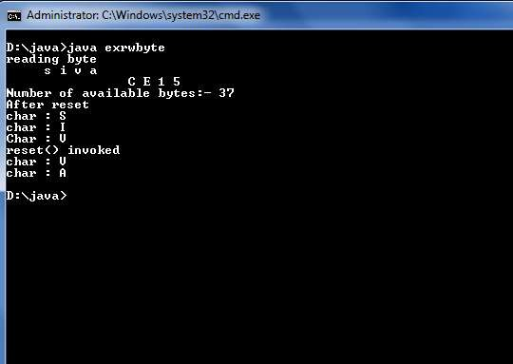
CS8392 Object Oriented Programming
Dr.D.Sivaganesan and N.Aravindhraj PSGiTech / CSE
7

Slide 8
import java.io.*;
public class FileWordCount
{
public static void main(String[] args) throws IOException
{
File f1=new File("input.txt"); //Creation of File Descriptor for input file
String[] words=null; //Intialize the word Array
int wc=0; //Intialize word count to zero
FileReader fr = new FileReader("D:/desktop-Backup-10-09-19/java/filep.java");
//Creation of File Reader object
BufferedReader br = new BufferedReader(fr); //Creation of BufferedReader
String s;
while((s=br.readLine())!=null) //Reading Content from the file
{
words=s.split(" "); //Split the word using space wc=wc+words.length; //increase the word count for each word
}
fr.close();
System.out.println("Number of words in the file:" +wc);
} }
//Print the word count
CS8392 Object Oriented Programming
Dr.D.Sivaganesan and N.Arvaindhraj PSGiTech / CSE
8

Slide 9
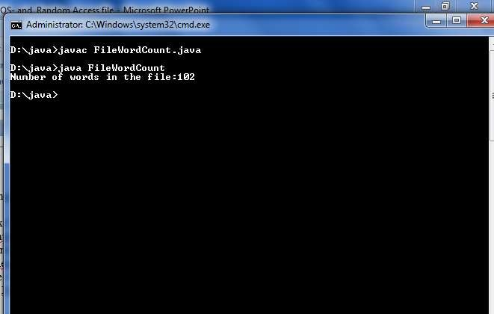
CS8392 Object Oriented Programming
Dr.D.Sivaganesan and N.Aravindhraj PSGiTech / CSE
9

Slide 10
import java.io.*;
public class FileLineCount
{
public static void main(String[] args) throws IOException
{
//File f1=new File(“filep.java"); //Creation of File Descriptor for input file
int linecount=0; //Intializing linecount as zero
FileReader fr=new FileReader("D:/desktop-Backup-10-09-19/java/filep.java");
//Creation of File Reader object
BufferedReader br = new BufferedReader(fr); //Creation of File Reader object
String s;
while((s=br.readLine())!=null) //Reading Content from the file line by line
{
linecount++; //For each line increment linecount by one
} fr.close();
System.out.println("Number of lines in the Files:"+linecount); //Print the line count
} }
CS8392 Object Oriented Programming
Dr.D.Sivaganesan and N.Aravindhraj PSGiTech / CSE
10

Slide 11
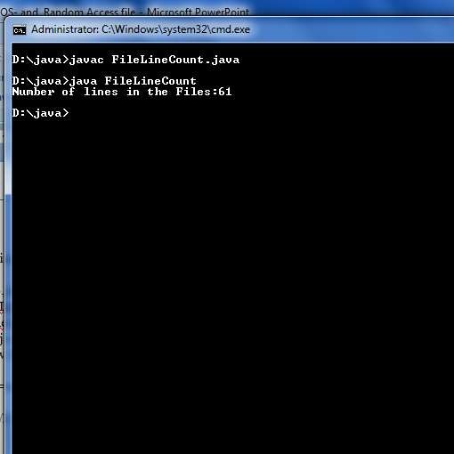
CS8392 Object Oriented Programming
Dr.D.Sivaganesan and N.Araindhraj PSGiTech / CSE
11

Slide 12
Random access files
Random access files permit non sequential, or random, access to a file's contents. To access a file randomly, you open the file, seek a particular location, and read from or write to that file.
RandomAccessFile obj= new RandomAccessFile(“file","rw");
Method
readInt()
readUTF(),readLine()
readFloat(), readChar()
seek(long pos)
writeDouble(double v),
writeFloat(float v)
write(int b)
read()
writeInt(int)
writeUTF()
CS8392 Object Oriented Programming
Dr.D.Sivaganesan and N.Aravindhraj PSGiTech / CSE
12

Slide 13
import java.io.IOException; import java.io.RandomAccessFile; import java.util.*;
public class exrand{
public static void main(String[] args)
{try
{ RandomAccessFile rf = new RandomAccessFile("random.txt","rw");
Scanner s=new Scanner(System.in);
int a;
a=s.nextInt();
rf.writeUTF("xssss");rf.writeInt(a); rf.writeDouble(3.123);rf.writeFloat(345.56f); rf.writeChar('k');rf.seek(0);
System.out.println("String :"+rf.readUTF());System.out.println("Integer :"+rf.readInt()); System.out.println("Double :"+rf.readDouble());System.out.println("Float :"+rf.readFloat()); System.out.println("Character :"+rf.readChar());
rf.close();
}
catch(IOException ex)
{System.out.println(ex);}}}
CS8392 Object Oriented Programming
Dr.D.Sivaganesan and N.Aravindhraj PSGiTech / CSE
13

Slide 14
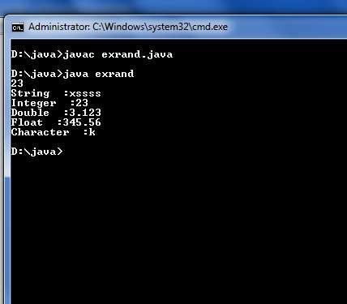
CS8392 Object Oriented Programming
Dr.D.Sivaganesan and N.Aravindhraj PSGiTech / CSE
14

Slide 15
import java.io.*; // Accessing File using RandomAccessFile
public class exfrrandom
{
public static void main(String[] args) throws IOException
{
try
{
RandomAccessFile rf = new RandomAccessFile("fwrite.java","r");
int temp;
while((temp = rf.read()) != -1)
System.out.print((char)temp);
}
}
}
CS8392 Object Oriented Programming
Dr.D.Sivaganesan and N.Aravindhraj PSGiTech / CSE
15

Slide 16
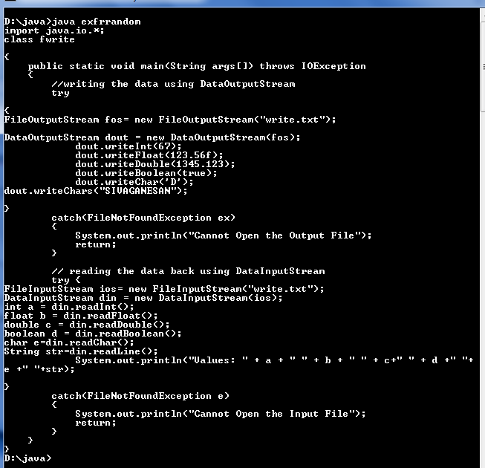
CS8392 Object Oriented Programming
Dr.D.Sivaganesan and N.Aravindhraj PSGiTech / CSE
16

Slide 17

CS8392 Object Oriented Programming
Dr.D.Sivaganesan and N.Arvindhraj PSGiTech / CSE
17

